Slide 1
Finding the perimeter of polygons
Perimeter and area

Slide 2
how to use Oak lessons

Slide 3
I can use the properties of a range of polygons to deduce their perimeters, including generalising a perimeter formula where appropriate.

Slide 4
A polygon is a flat (2D), closed figure made up of straight line segments.
The perimeter is the distance around a 2D shape.

Slide 5

Finding the perimeter of polygons
Efficiently calculating perimeter
Using formulas for perimeter

Slide 6
Efficiently calculating perimeter
Perimeter is the distance around a 2D shape.
This can be calculated by summing all of the edges together.
Repeated addition can be calculated more efficiently through the use of number bonds and multiplication.

Slide 7
Efficiently calculating perimeter
The perimeter of this square can be found in different ways.
Perimeter = 5 + 5 + 5 + 5
= 20 units
Perimeter = 5 × 4
= 20 units
5 units

Slide 8
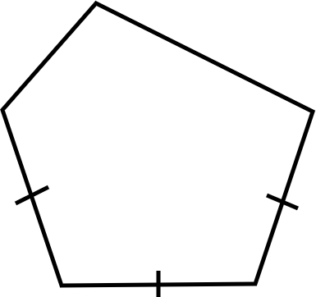
Efficiently calculating perimeter
Which method do you prefer? When might you use each?
3 cm
7 cm
4 cm
Lucas’s method
Perimeter = 3 + 4 + 4 + 4 + 7
= 7 + 4 + 4 + 7
= 11 + 4 + 7
= 15 + 7
= 22 cm
Andeep’s method
Perimeter = 3 + 7 + 3 × 4
= 10 + 12
= 22 cm

Slide 9
Efficiently calculating perimeter
Which method do you prefer? When might you use each?
Lucas’s method
Perimeter = 3 + 4 + 4 + 4 + 7
= 7 + 4 + 4 + 7
= 11 + 4 + 7
= 15 + 7
= 22 cm
Andeep’s method
Perimeter = 3 + 7 + 3 × 4
= 10 + 12
= 22 cm
E.g. I prefer Andeep’s method because it involves fewer steps.
I would use Lucas’s method when all the values are different.

Slide 10

Efficiently calculating perimeter
1) Calculate the perimeter of each polygon.
Evaluate your approach and determine if you could be more efficient.
a) b) c)
5 cm
7.5 in
5.3 in
4.4 in
3 mm
5 cm
4 cm
2 in
6 in
4 cm
3 in

Slide 11
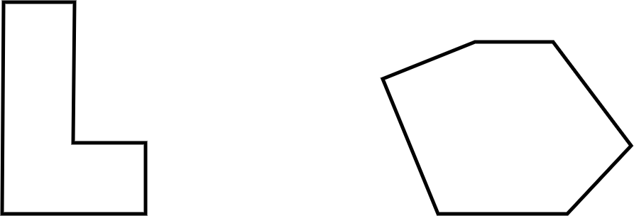
Efficiently calculating perimeter
1) Calculate the perimeter of each polygon.
Evaluate your approach and determine if you could be more efficient.
d) e)
2 ft
3.7 m
5.2 m
4 ft
9.8 m
6 ft
2 ft
11.3 m
2 ft
6.4 m
4 ft
8.6 m

Slide 12
Efficiently calculating perimeter
1) Calculate the perimeter of each polygon.
Evaluate your approach and determine if you could be more efficient.
a)
E.g.
Perimeter = 3 × 6
= 18 mm
This is more efficient than repeated addition as there are fewer steps in the overall calculation.
3 mm

Slide 13
Efficiently calculating perimeter
1) Calculate the perimeter of each polygon.
Evaluate your approach and determine if you could be more efficient.
b)
E.g.
Perimeter = 2(4 + 5)
= 18 cm
This is more efficient than repeated addition as there are fewer steps in the overall calculation.
This is more efficient than 2 × 4 + 2 × 5 as my way involves two steps, rather than three.
5 cm
5 cm
4 cm
4 cm

Slide 14
Efficiently calculating perimeter
1) Calculate the perimeter of each polygon.
Evaluate your approach and determine if you could be more efficient.
c)
E.g.
Perimeter = 2 + 3 + 6 + 4.4 + 5.3 + 7.5
= 28.2 in
I could not see a more efficient way as I could not spot any useful number bonds nor could I use multiplication in place of repeated addition.
7.5 in
5.3 in
4.4 in
2 in
6 in
3 in

Slide 15
Efficiently calculating perimeter
1) Calculate the perimeter of each polygon.
Evaluate your approach and determine if you could be more efficient.
d)
2 ft
E.g.
Perimeter = 2 × (6 + 4)
= 20 ft
I could see lots of ways to work this perimeter out. I realised there were two lots of 6 and two lots of 4 so I used the distributive law to be more efficient.
4 ft
6 ft
2 ft
2 ft
4 ft

Slide 16
Efficiently calculating perimeter
1) Calculate the perimeter of each polygon.
Evaluate your approach and determine if you could be more efficient.
e)
3.7 m
5.2 m
E.g.
Perimeter = 15 × 3
= 45 m
I spotted that 8.6 and 6.4 sum to 15.
I then saw 5.2 + 9.8 = 15 and 11.3 + 3.7 = 15. I then realised I had 3 lots of 15.
9.8 m
11.3 m
6.4 m
8.6 m

Slide 17
Finding the perimeter of polygons
Efficiently calculating perimeter
Using formulas for perimeter

Slide 18
Using formulas for perimeter
Perimeter can always be calculated through summing all of the edge lengths.
Using the properties of certain polygons, we can write a formula to calculate the perimeter in an efficient way.

Slide 19

Using formulas for perimeter
A square has four sides of equal length.
The perimeter (P) of the square can be written as:
A regular octagon has 8 sides of equal length.
b
a
The perimeter (P) of the octagon can be written as:
P = 4a
P = 8b

Slide 20

Using formulas for perimeter
Here is a rectangle.
The perimeter (P) of the rectangle can be written as:
Here is a kite.
d
a
e
b
The perimeter (P) of the kite can be written as:
P = 2a + 2b
P = 2d + 2e

Slide 21

Using formulas for perimeter
1) a) Match the shape to a formula that could be used to find its perimeter.
P = a + 2b + c
P = t + r + w
P = 10k

Slide 22
Using formulas for perimeter
1) b) Calculate the perimeter of each shape using your chosen formula.
3.4 cm
5 cm
6 cm
5 cm
4 cm
8 cm
3 cm
P = a + 2b + c
P = t + r + w
P = 10k

Slide 23
Using formulas for perimeter
1) c) Consider each answer. Was the formula useful?
3.4 cm
5 cm
6 cm
5 cm
4 cm
8 cm
3 cm
P = a + 2b + c
P = t + r + w
P = 10k

Slide 24
Using formulas for perimeter
1) a) Match the shape to a formula that could be used to find its perimeter.
P = a + 2b + c
P = t + r + w
P = 10k

Slide 25
Using formulas for perimeter
1) b) Calculate the perimeter of each shape using your chosen formula.
P = 10k
= 10 × 5
= 50
Perimeter is 50 cm
5 cm

Slide 26
Using formulas for perimeter
1) b) Calculate the perimeter of each shape using your chosen formula.
3.4 cm
P = a + 2b + c
= 3.4 + 2 × 6 + 8
= 23.4
Perimeter is 23.4 cm
6 cm
8 cm

Slide 27
Using formulas for perimeter
1) b) Calculate the perimeter of each shape using your chosen formula.
P = t + r + w
= 5 + 3 + 4
= 12
Perimeter is 12 cm
5 cm
4 cm
3 cm

Slide 28
Using formulas for perimeter
1) c) Consider each answer. Was the formula useful?
P = a + 2b + c
P = t + r + w
P = 10k
E.g.
The formula for the star was helpful as I didn’t have to do lots of addition.
The formula for the isosceles trapezium was sort of helpful as it was only doubling one value.
The formula for the triangle was not helpful as it was the same as just adding.

Slide 29
Finding the perimeter of polygons
Perimeter is the distance around a 2D shape.
This can always be found by summing the lengths of all edges.
For some polygons, it may be more efficient to consider multiplication and/or number bonds.

Slide 30

© Oak National Academy 2024.
Produced in partnership with Mathematics in Education and Industry.
Licensed on the Open Government Licence v3.0, except where otherwise stated. See Oak terms and conditions.

